Slide 1
Sonar Sensor with the Implementation
CSE 315
Peripherals & Interfacing
Credit:
Abdullah Al Omar
Lecturer, CSE, UAP

Slide 2
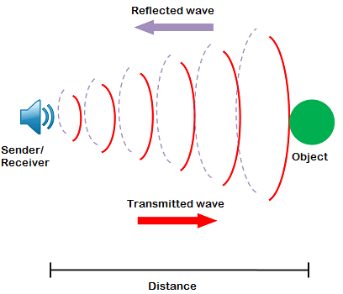
What is Sonar?
Sonar is a technique that uses sound propagation to navigate, communicate with or detect objects on or under the surface of the water.

Slide 3
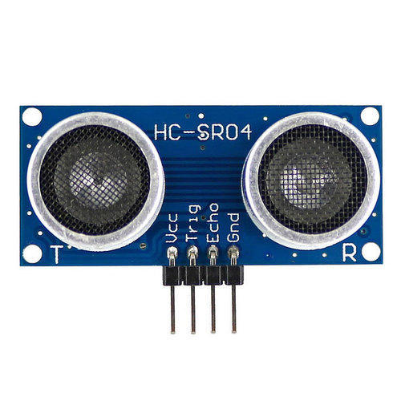
Ultrasonic Sensor
An Ultrasonic sensor is a device that can measure the distance to an object by using sound waves.

Slide 4
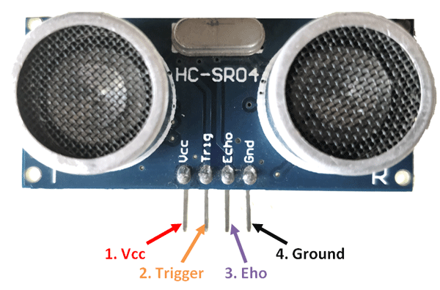
Pin Configuration
VCC
The Vcc pin powers the sensor, typically with +5V
Trig
Trigger pin is an Input pin. This pin has to be kept high for 10us to initialize measurement by sending US wave.
Echo
Echo pin is an Output pin. This pin goes high for a period of time which will be equal to the time taken for the US wave to return back to the sensor.
GND
This pin is connected to the Ground of the system.

Slide 5
Features:
Operating voltage: +5V
Theoretical Measuring Distance: 2cm to 450cm
Practical Measuring Distance: 2cm to 80cm
Accuracy: 3mm
Measuring angle covered: <15°
Operating Current: <15mA
Operating Frequency: 40Hz
Trigger Input Pulse width: 10uS

Slide 6
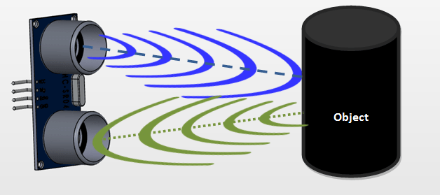



Working principle
1
2
3
The transmitter (trig pin) sends a signal: a high-frequency sound.
When the signal finds an object, it is reflected and back toward the sensor
And the receiver(echo pin) receives/observed it.

Slide 7


Applications
Obstacles finding robots
Easy Control of Trash Collection Vehicles
biped robot, obstacle avoider robot, path finding robot etc.
Vehicle Detection
Liquid Level Sensing
Car Washes,
Automotive Assembly, and Parking Garage Applications
Water Depth Sensing with Ultrasonic and Wastewater Management
Product for Blind people
Mapping
Smart (gloves, white cane, shoe, hat) etc.
150 ultrasonic projects
https://www.hackster.io/projects/tags/ultrasonic

Slide 8
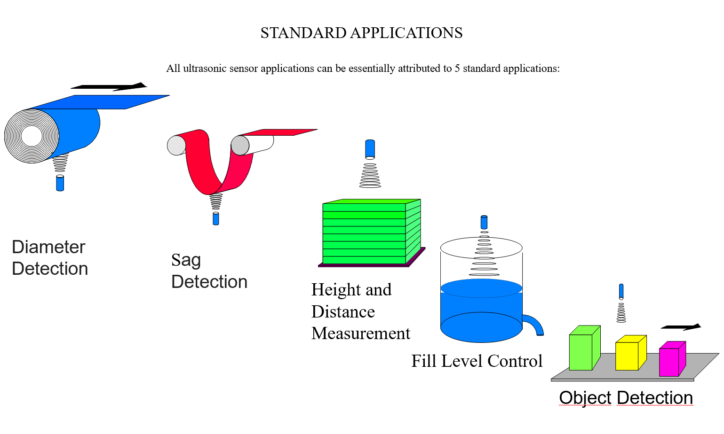
Contd…

Slide 9
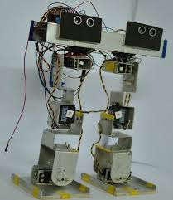
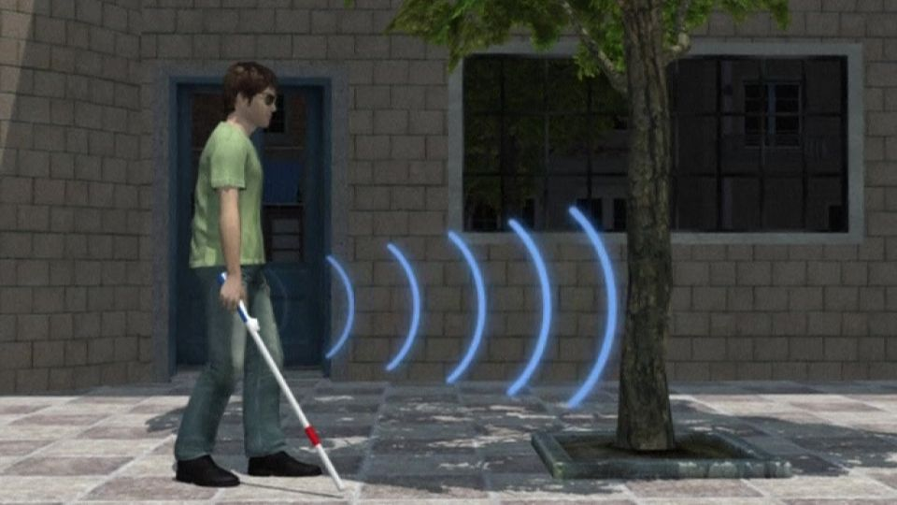
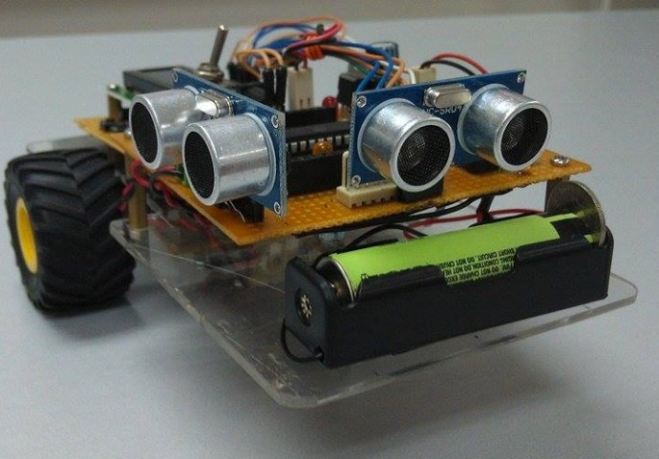
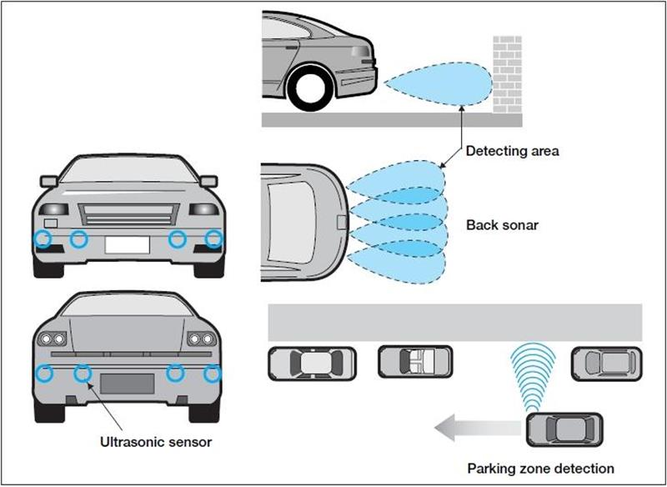
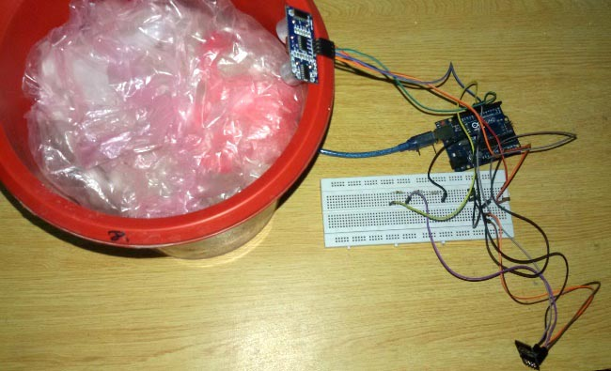
Contd….
Intelligent self balance robot
Smart White Cane
Wall follower robot
Trash level detection
Car parking

Slide 10
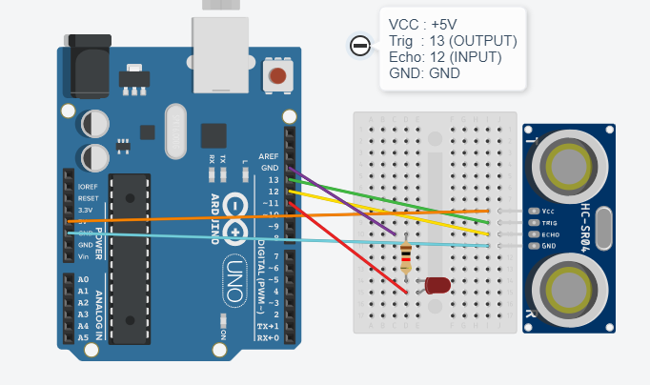
Diagram :

Slide 11
Code:
const int trigPin = 13;
const int echoPin = 12;
const int led = 11;
void setup()
{
Serial.begin (9600);
pinMode(trigPin, OUTPUT);
pinMode(echoPin, INPUT);
pinMode(led, OUTPUT);
}
void loop()
{
long duration, distance;
digitalWrite(trigPin, LOW);
delayMicroseconds(2);
digitalWrite(trigPin, HIGH);
delayMicroseconds(10);
digitalWrite(trigPin, LOW);
duration = pulseIn(echoPin, HIGH);
distance = (duration/2) * 0.034;
Serial.print("The distance is: ");
Serial.println(distance);
if (distance < 10)
{
digitalWrite(led,HIGH);
}
else {
digitalWrite(led,LOW);
}
}

Slide 12
Distance= velocity * time
s= 343 m/s * (duration/2) [As the duration of time has been calculated for two ways]
s= 34300 cm/s * (duration/2)
s= 34300/1000000 cm/micro-sec * (duration/2)
s= 0.0343 cm/us * (duration/2)

Slide 13
Hardware Requirements (Proteus)
Arduino
LED
Pot & Pot HG
Ultrasonic V2.0 B

Slide 14
Library for Proteus
Put the following in the path:
C>Program data>Labcenterelectronics>Proteus8Professional>Library
Files name:
1. UltrasonicTEP.HEX
2. UltrasonicTEP
3. UltrasonicTEP.LIB

Slide 15
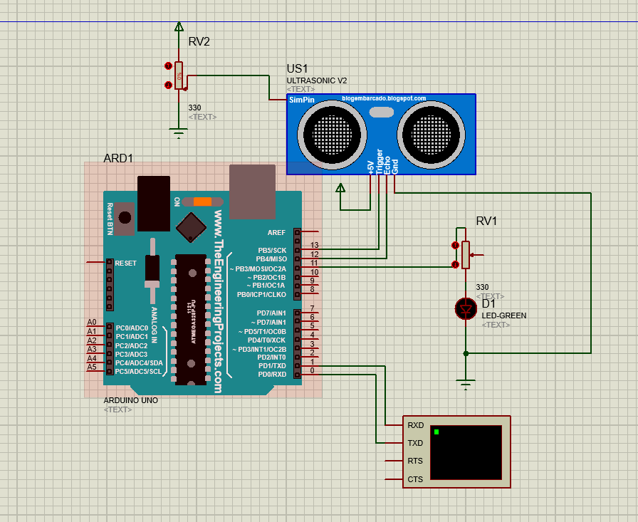
Proteus integration

Slide 16
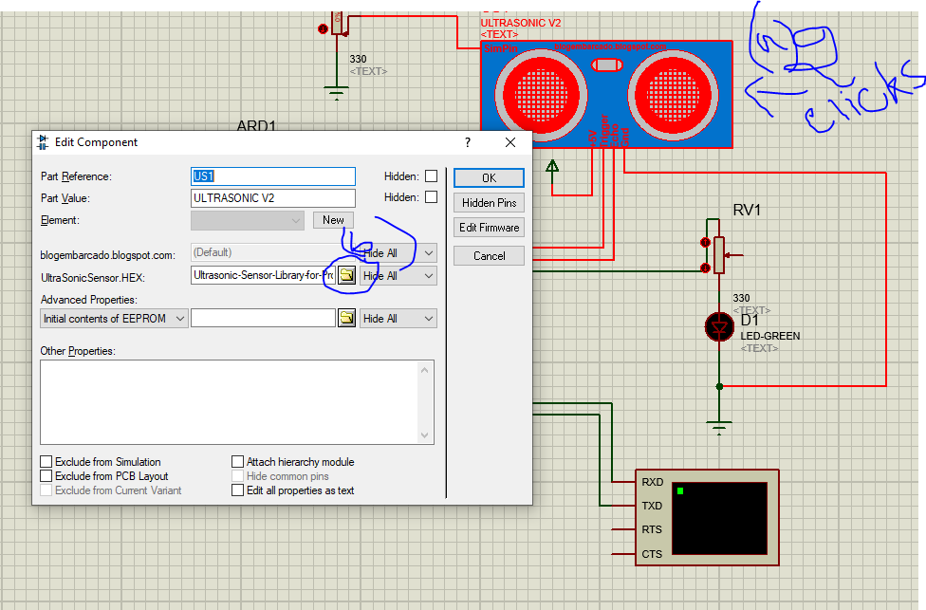
Proteus integration

Slide 17
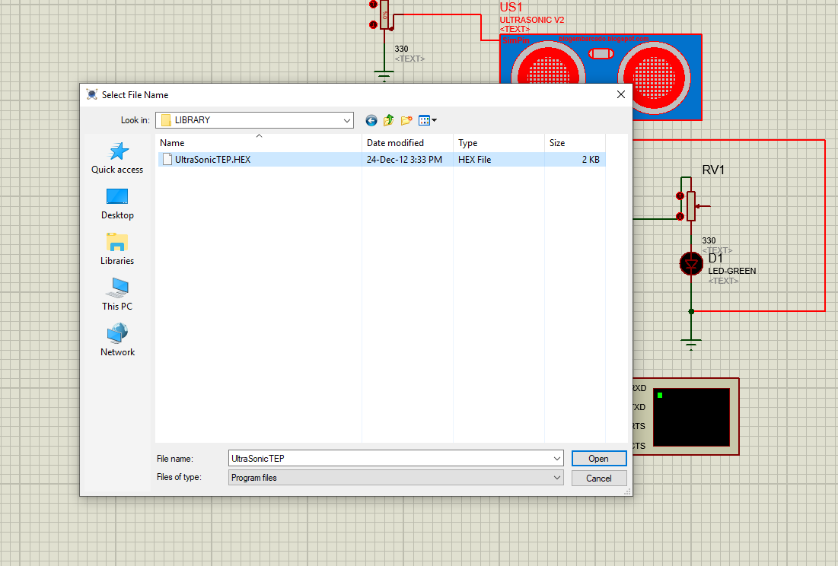
Proteus integration

Slide 18
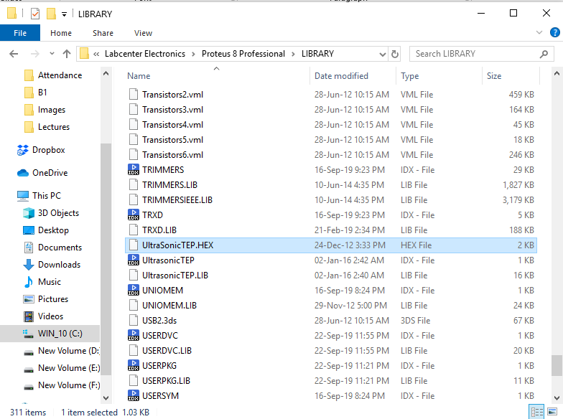
Library Path
C:\ProgramData\Labcenter Electronics\Proteus 8 Professional\LIBRARY\UltrasonicTEP.HEX

Slide 19
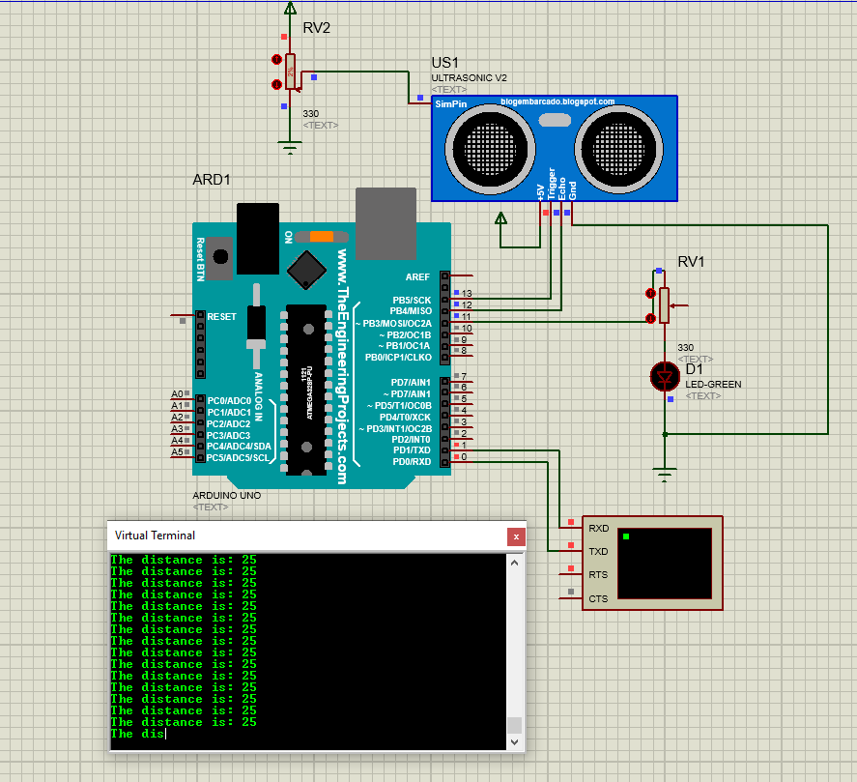
Proteus integration (working)

Slide 20
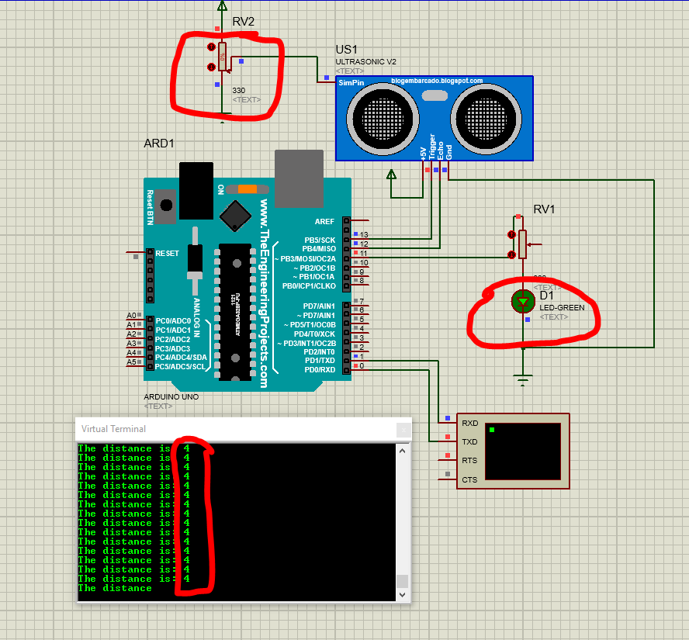
Proteus integration (working)-value less than 10

Slide 21
pulseIn():Reads the echoPin, returns the sound wave travel time in microseconds. if value is HIGH, pulseIn() waits for the pin to go HIGH, starts timing
Distance = Speed × Time ; here universal speed of US wave at room conditions is 340m/s. convert to 0.034 cm/us.
Duration: divide the duration by 2 because the wave was sent, hit the object, and then returned back to the sensor.

Slide 22
THANK YOU

